Slide 1


Turntable MERG Arduino SIG
Part 3: Alans Solution
Alan Lomax M8640
Notes:
MERG presentation for the Arduino SIG.

Slide 2
Agenda

Slide 3

Turntable
Stop
LCD
Speed
Control
12 VDC Power
Switch
Home
I2C
AI
CCW
Arduino NANO R3
On a Shield
Motor Shield
AI
CW
DO x 4
FLIP
DO x 3
DI
DI
DI
Hall Effect #1
Hall Effect #2
Hall Effect #3
Turntable
LED #1
LED #2
LED #3
12 VDC Motor
Magnet on Bridge
Notes:
This Slide builds up in steps .. .talk about each item as it appears.
The final software for this did not just appear to me in a vision … there were many iterations of it and countless problems to be solved along the way.
As the code got bigger it became more difficult to maintain (more importantly difficult to understand) .. If I left it for a few days it was difficult to get back immersed in it.
I had read about class programming, and I know that I had used software classes … but now it was time to write my own!
Initially It was a self assigned study … told myself “I am going to learn this!” …. Which very quickly became “Wow .. This is so much easier”
My objective here … is to make the case for using Class programming in certain situations
And hopefully take a lot of the mystery out of it.

Slide 4
Turntable SW Classes and Usage
Software LED object allow for blinking LED’s without using delay().
Can set on time, off time, read the current state and turn on or off.
LED
Button
Treat button inputs as a software object. Debounce without delay()
Motor
Treat motor as a software object. Stop, start, speed and direction
A general purpose timer class. Monitor an input, Set both ‘on delay’ and ‘off delay’ values. Can read the output property as to whether it is on or off. Again no delay() function.
DblDelay
Treat LCD display as a software object. Using the data sheet I implemented each command it could understand. Then I combined some of these to make up new and more powerful commands. (simplifying the sketch)
LCD
Notes:
So what classes do I end up creating.?
Talk them through – very high level. Each one evolved to fill a need.
There a few themes that might already be apparent to you.
None of the above is a complete program … but each is like a ‘LEGO BRICK’ which we can use to build something bigger
No calls to delay() (say a few words what delay() does) LED blinking example
Complexity can be hidden inside these LEGO BRICKS and it is not necessary to see that complexity to use the bricks.

Slide 5
Questions?
Part 6
Some Backup Material Follows
Back to Agenda

Slide 6
Backup Material

Slide 7
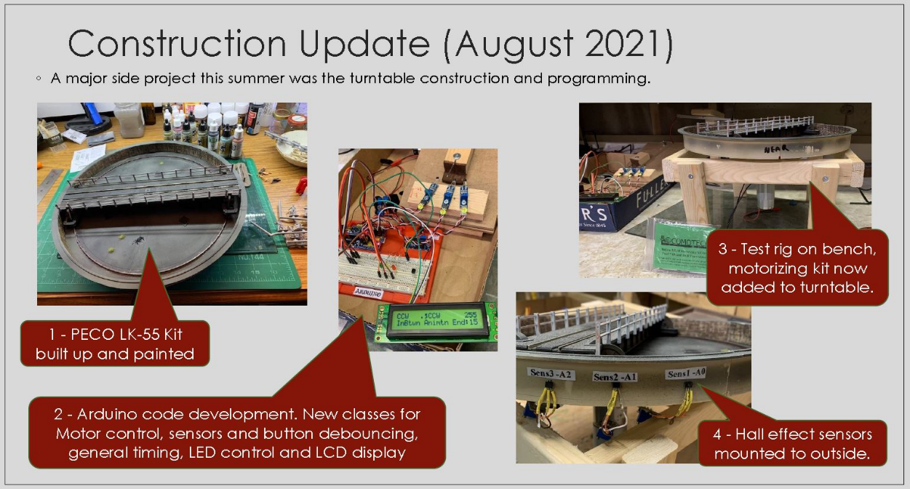
My Motivation
Notes:
Show people that this can be about modelling on railways.
It is not just deep in the weeds Arduino programming.

Slide 8
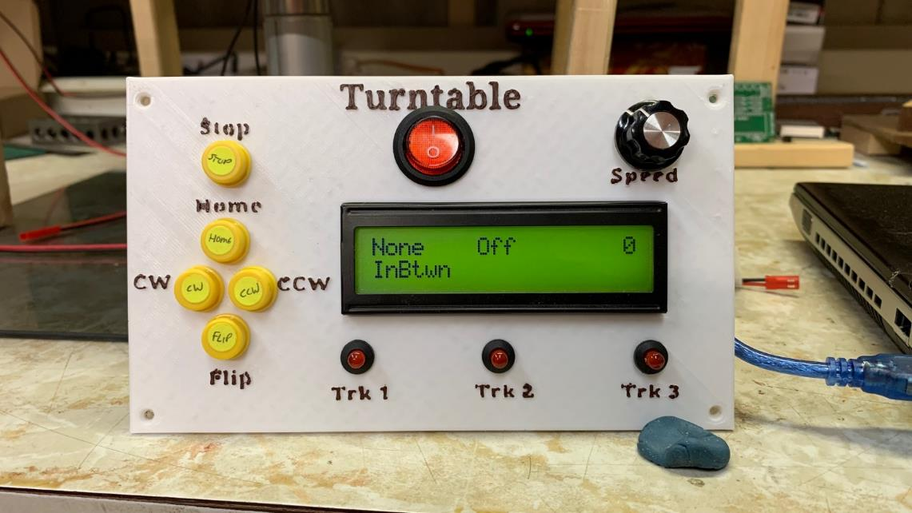
My Motivation
Notes:
User interface – 5 buttons .. One speed control potentiometer one LCD screen (With 6 separate data regions showing 6 status items) 3 LED’s for when turntable bridge is in a specific position.
Other Inputs – 3 HALL effect sensors on outside of turntable well … detect micro magnets attached to each end of the bridge as it rotates.
Other outputs – DC motor control direction and speed control.
Logic – depending on button press move in the correct direction until hall effect sensor is detected.
All controlled by one Arduino NANO.

Slide 9
References and Additional Material

